Slide 2
Breast cancer is an uncontrolled growth of breast cells. To better understand breast cancer, it helps to understand how any cancer can develop and the vast amounts of people affected by it in the U.S.

Slide 3
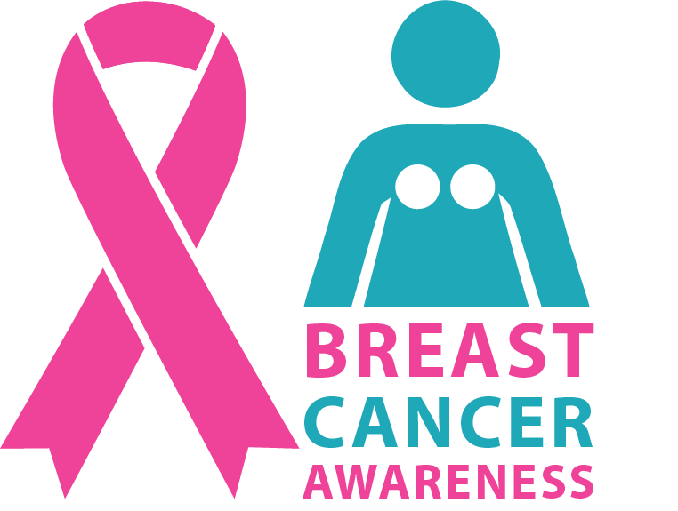
STATS
About 1 in 8 U.S. women (about 12.4%) will develop invasive breast cancer over the course of her lifetime.
The Burden of Cancer in the United States

Slide 4
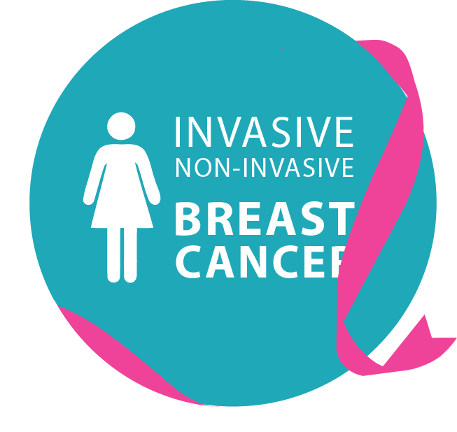
Invasive Non-invasive
In 2018, an estimated 266,120 new cases of invasive breast cancer are expected to be diagnosed in women in the U.S., along with 63,960 new cases of non-invasive (in situ) breast cancer.

Slide 5
STATS
A Man’s Lifetime Risk
About 2,550 new cases of invasive breast cancer are expected to be diagnosed in men in 2018. A man’s lifetime risk of breast cancer is about 1 in 1,000.

Slide 6
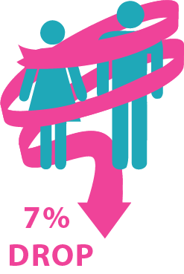
One theory is that this decrease was partially due to the reduced use of hormone replacement therapy (HRT) by women after the results of a large study called the Women’s Health Initiative were published in 2002.
Breast cancer incidence rates in the U.S. began decreasing in the year 2000, after increasing for the previous two decades. They dropped by 7% from 2002 to 2003 alone.
These results suggested a connection between HRT and increased breast cancer risk.

Slide 7
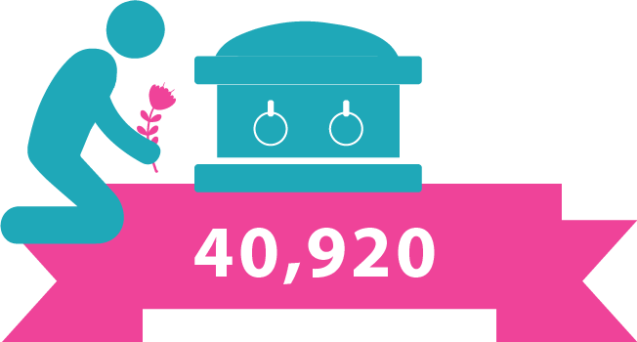
About 40,920 women in the U.S. are expected to die in 2018 from breast cancer, though death rates have been decreasing since 1989.
Women under 50 have experienced larger decreases. These decreases are thought to be the result of treatment advances,
earlier detection through screening, and increased awareness.
The Burden of Cancer in the United States
7

Slide 8
STATS
For women in the U.S., breast cancer death rates are higher than those for any other cancer, besides lung cancer.
The Burden of Cancer in the United States

Slide 9
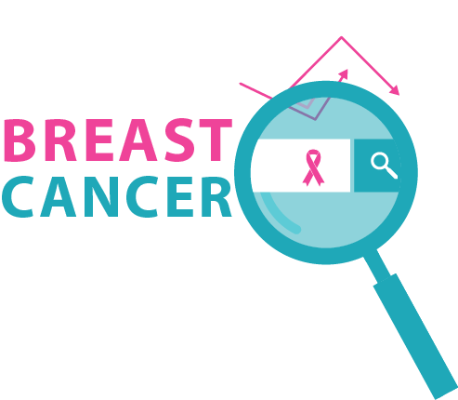
STATS
Besides skin cancer, breast cancer is the most commonly diagnosed cancer among American women.
In 2017, it's estimated that about 30% of newly diagnosed cancers in women will be breast cancers.
The Burden of Cancer in the United States

Slide 10
For Asian, Hispanic, and Native-American women, the risk of developing and dying from breast cancer is lower.
Overall, African-American women are more likely to die of breast cancer.
In women under 45, breast cancer is more common in African-American women than white women.
The Burden of Cancer in the United States

Slide 11
STATS
History of Breast Cancer
As of January 2018, there are more than 3.1 million women with a history of breast cancer in the U.S.
This includes women currently being treated and women who have finished treatment.

Slide 12
STATS
A woman’s risk of breast cancer nearly doubles if she has a first-degree relative (mother, sister, daughter) who has been diagnosed with
breast cancer.
Less than 15% of women who get breast cancer have a family member diagnosed with it.
The Burden of Cancer in the United States
12

Slide 13
STATS
Gene Mutations
About 5-10% of breast cancers can be linked to gene mutations (abnormal changes) inherited from one’s mother or father.
5-10%
Genes
45%
Ovarian
6.8%

Slide 14
STATS
Gene Mutations
Mutations of the BRCA1/2 genes are the most common. BRCA1 women have a 55-65% lifetime risk of developing breast cancer.
5-10%
Genes
45%
Ovarian
6.8%

Slide 15
STATS
Gene Mutations
BRCA2 women = 45% risk. Breast cancer that is positive for the BRCA1/2 mutations tends to develop more often in younger women.
5-10%
Genes
45%
Ovarian
6.8%

Slide 16
STATS
Gene Mutations
It so happens that an increased ovarian cancer risk is also associated with these genetic mutations.
5-10%
Genes
45%
Ovarian
6.8%

Slide 17
STATS
Gene Mutations
BRCA2 men mutations are associated with a lifetime cancer risk of about 6.8%; BRCA1 are a less frequent cause of breast cancer in men.
5-10%
Genes
45%
Ovarian
6.8%

Slide 18
History of Breast Cancer
About 85% of breast cancers occur in women who have no family history of breast cancer. These occur due to genetic mutations that happen as a result of the aging process and life in general, rather than inherited mutations.

Slide 19
STATS
Being a Woman
The most significant risk factors for breast cancer are gender (being a woman) and age (growing older).

Slide 20
Your Support Means Help for Millions of Women.
Get Involved.
Donate@: www.bcrf.org

